Slide 1
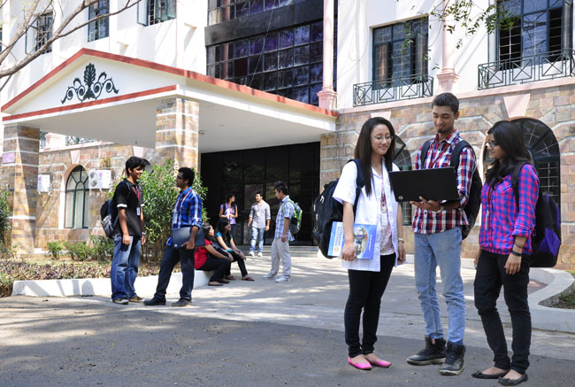

CSB4301 – Theory of Computation
B.Tech – IVth Semester
Mr. D.S.John Deva Prasanna AP(SG) & Ms.Vanathi, AP(SS)
Department of Computer Science and Engineering

Slide 2
Theory of Computation
The field is divided into three major branches:
automata theory,
computability theory
computational complexity theory.

Slide 3
Type of Theorem Proving
We look at some theorem proving techniques. These are used as proof of concept in automata theory.
Deductive Proofs
Consists of sequence of statements whose truth leads us from hypothesis (theorem) to conclusion.
Proof by contradiction
We assume the hypothesis to be false and prove the conclusion is also false in that case .
Proof by counter example
Try to prove that the theorem is false and prove by failed attempt
Proof by induction
The theorem will be proven for lower values first and then will be proved for higher values

Slide 4

Deductive Proofs
Theorem: “The sequence of statements whose truth leads from a given statement(s-hypothesis) to a conclusion statement (what we want to prove)”
Lets try some cases
X=1 2>1 – Satisfied
X=2 4>4 – partially satisfied
X=3 8>9 – not satisfied
X=4 16>16 – partially Satisfied
X=5 32>25 - Satisfied
X=6 64>36 - Satisfied
Here we need to observe the pattern of value increase

Slide 5



Deductive Proof continued
The ratio of increase is 2 in case 2^x
The ratio of increase for x^2 will be
Which (1.25)^2 = 1.5625
2 > 1.5625
So from the know facts we can infer that

Slide 6
Deductive Proofs
A DIFFERENT VERSION OF THE SAME THEOREM
“If x is the sum of squares of four positive integers then then 2^{x} ≥ x².”
Let Claim 1: If x≥4, then 2^{x}≥x².
Let x be any number which is obtained by adding the squares of 4 positive integers.
Claim 2:
Given x and assuming that Claim 1 is true, prove that 2^{x}≥x²
Proof:
Given: x = a² + b² + c² + d²
Given: a≥1, b≥1, c≥1, d≥1
➔ a²≥1, b²≥1, c²≥1, d²≥1 (by 2)
➔ x ≥ 4 (by 1 & 3)
➔ 2^{x} ≥ x² (by 4 and Claim 1)

Slide 7


Reduction to definitions
“ if you are not sure of how to start a proof then convert all terms in the hypothesis to their definition.
Example Term : ‘S’ is a finite set
Definition : there exists a positive number ‘n’ representing the number of elements in ‘S’
|S|=n
Example Term : ‘U ‘ is infinite
Definition : there is no positive integer ‘n’ that represents the number of elements in ‘U’
Example Term: if ‘S’ and ‘T’ are subsets of a infinite set ‘U’ and T is complement of S then
Definition:

Slide 8
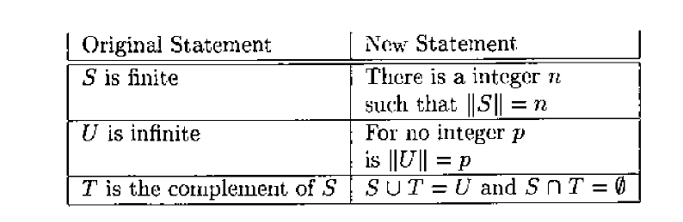
Reduction to definitions If ‘S’ is a finite subset of some infinite set ‘U’ and ‘T’ is a complement of ‘S’ with respect to ‘U’ then ‘T’ is infinite
Here |S| = n for some ‘n’ since ‘S’ is finite set
Here |S|+|T|=|U|
Let us assume
|T| = m for some ‘m’ (actually m cannot exist as T is infinite but we are assuming a contradiction here)
Then
|S|+|T|=|U| will imply m+n = q . Here q is the number of elements in ‘U’ which contradicts with the statement in theorem statement
Hence it is proven that ‘T’ cannot be finite.

Slide 9
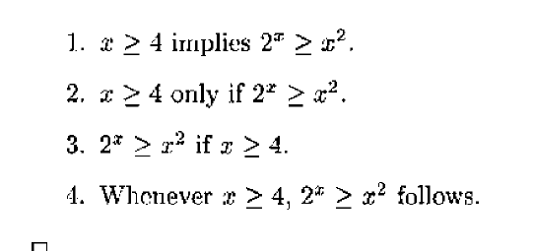
Topic 1 Different ways of expressing “If H then C” {H-> hypothesis and C-> conclusion}
H implies C
H only if C
C if H
Whenever H holds, C follows

Slide 10
if and only if statements
A if and only if B === A iff B
The above statement has got two parts
1. if A then B
2. if B then A
Simple example
Theorem : For any real number ‘x’, then floor(x)=ceiling(x) if and only if ‘x’ is an integer
Step 1: Assume floor(x)=ceiling(x) and prove x is integer. (if part)
Step 2: Assume x is integer and prove floor(x)=ceiling(x) (only if part)
Before we have to consider the facts
Floor(x)<=x ex: floor(6.5) = 6
Ceiling (x)>= x ex: ceiling(6.5)=7

Slide 11
Proving the Theorem : For any real number ‘x’, then floor(x)=ceiling(x) if and only if ‘x’ is an integer
The if part -- Assume floor(x)=ceiling(x) and prove x is integer.
floor(x)<=x ; --(1)
ceiling(x)>=x --(2)
But we know floor(x)=ceiling(x) so replace ceiling(x) with floor(x) in inequality (2)
Then we will get
floor(x)<=x & floor(x)>=x then by mathematical inequality
floor(x)=x ➔ hence it is proved that x is an integer.
Now the only if part -- Assume x is integer and prove floor(x)=ceiling(x)
If we assume x as an integer then
floor(x)=x
ceiling(x)=x
Hence floor(x)=ceiling(x) /////// Hence proved

Slide 12
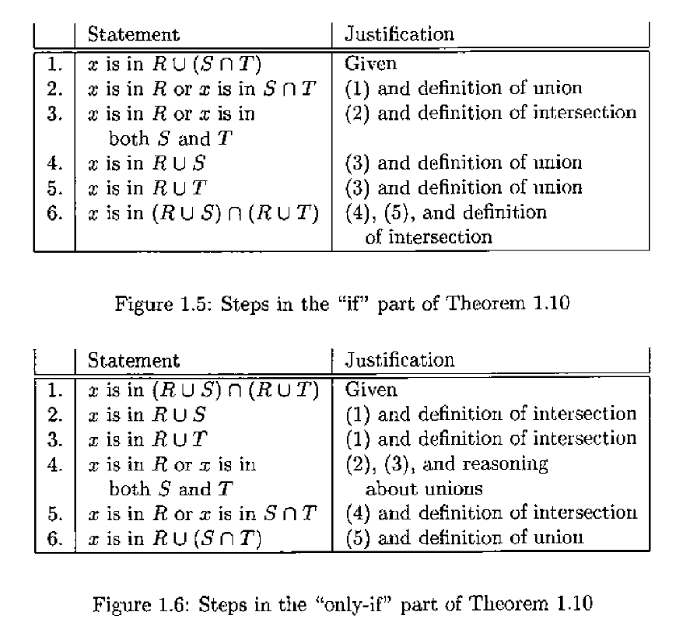
Proving equivalency in Sets :In automata we will be often proving the equivalency of sets among languages. We try to prove RՍ(S Ո T)= (RՍS) Ո (RՍT) (Remember your set theoretical notations)

Slide 13
Contrapositives
The contrapositive of the theorem
If H then C
will be
If not C then not H
OBSERVE THEY BOTH ARE LOGICALLY EQUIVALENT.
H and C both true
H true and C false ←
C true and H false
H and C both false

Slide 14
Thank You

